Slide 1
BBB Mini Drone
Real-Time Embedded Systems
Prof. Dr. Rolf Becker
Members:
Asad Ali Bhatti (23015)
Deep Sureshkumar Bhatt (20975)

Slide 2
OUTLINE
Introduction
Components used
Approach
Implementation
Future Enhancements

Slide 3
INTRODUCTION

Slide 4
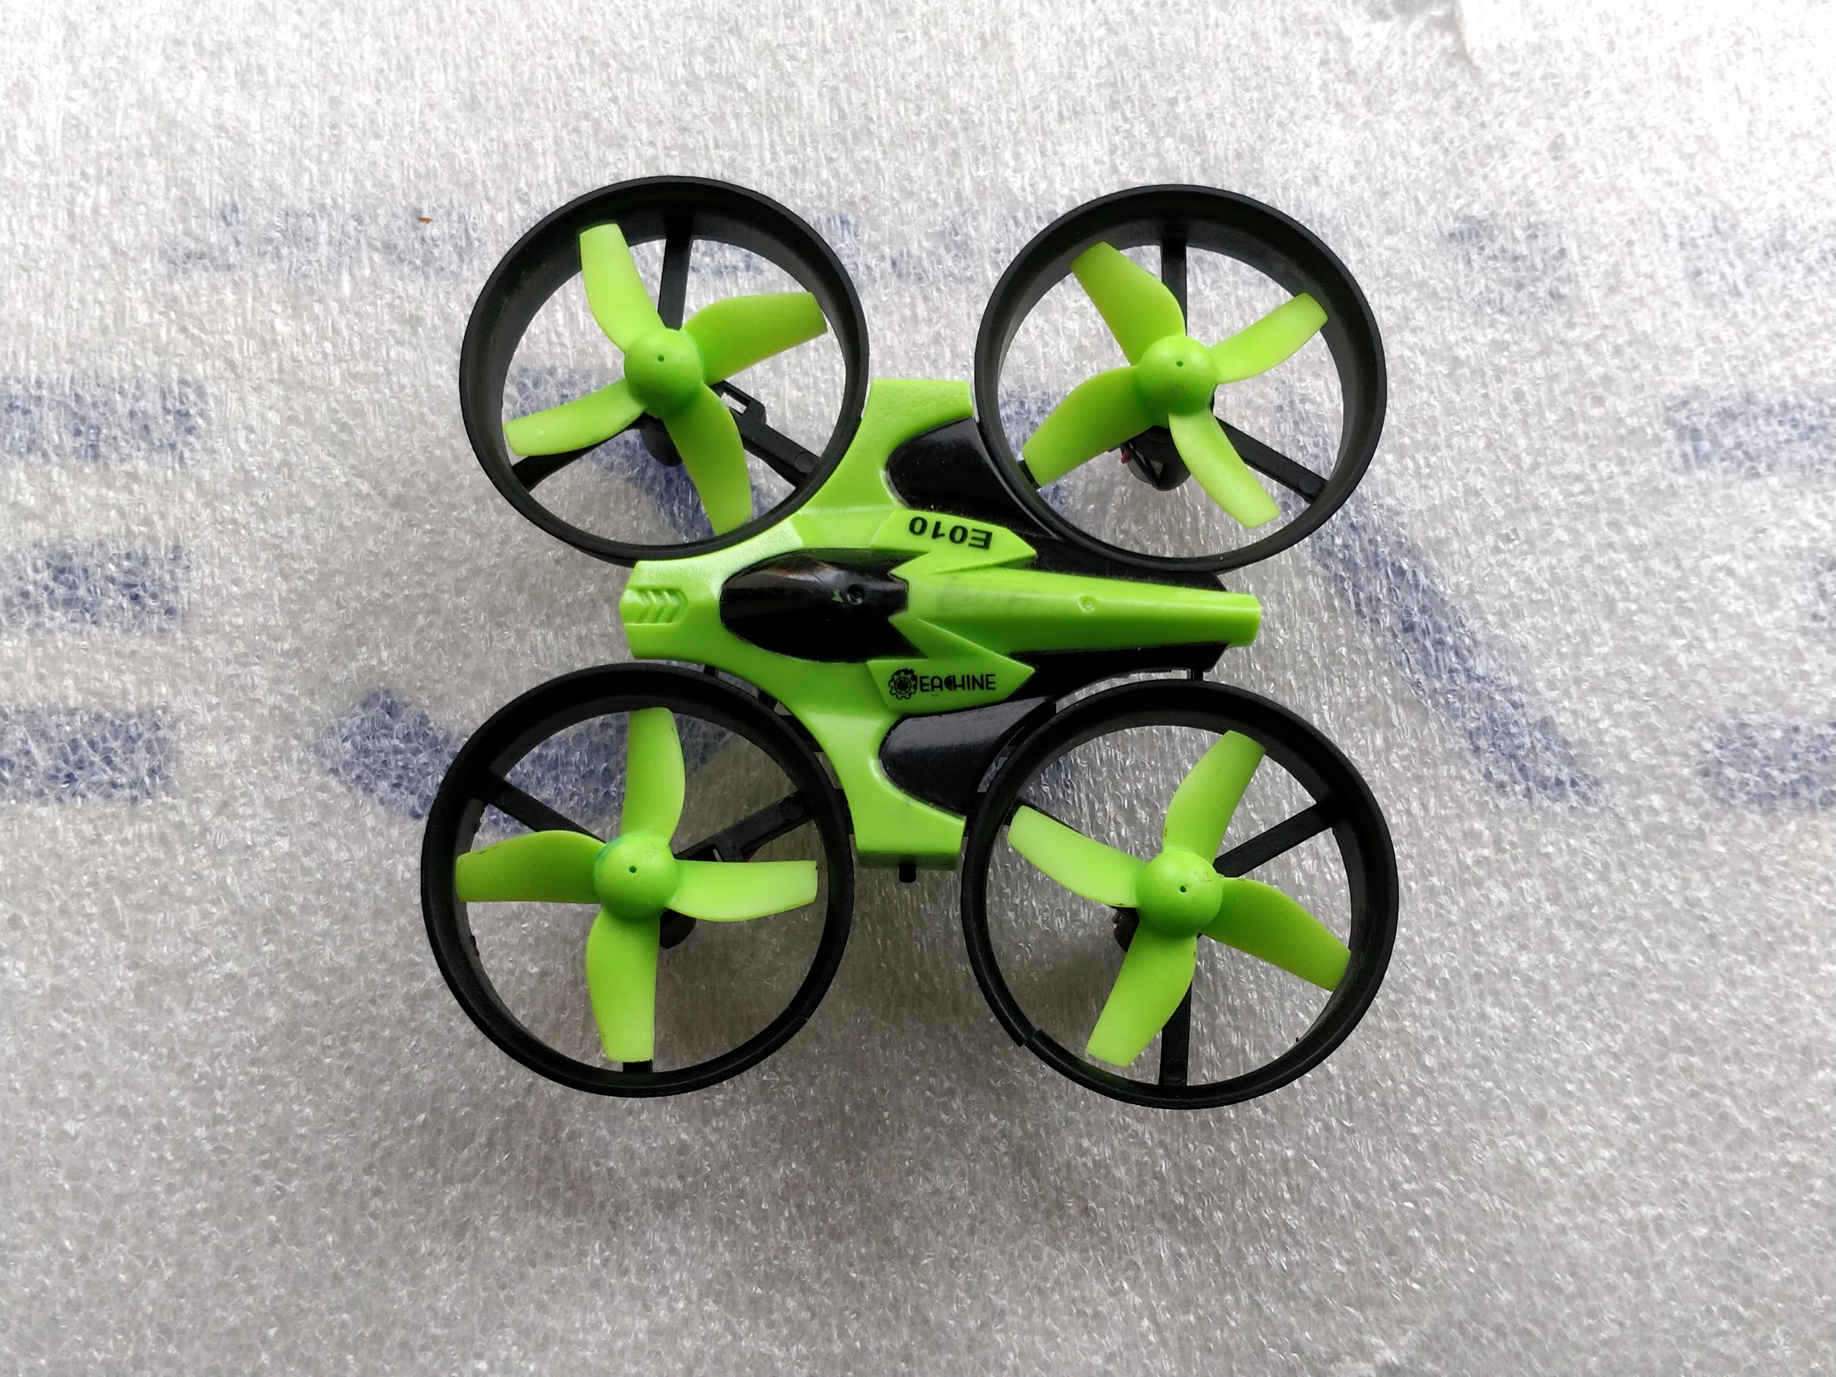
Problem statement
Flying a mini-drone by giving
All the commands from the
Computer.

Slide 5
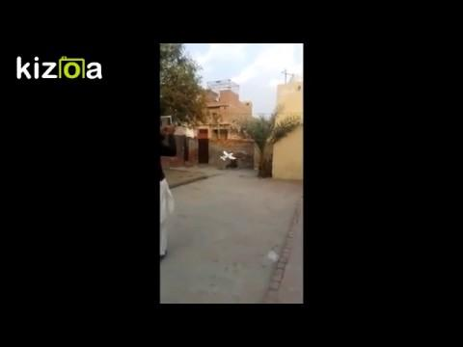
MOTIVATION

Slide 6
MOTIVATION
Chance of working on Drones.
Research
Extremely difficult challenges
Initial step

Slide 7
Components

Slide 8
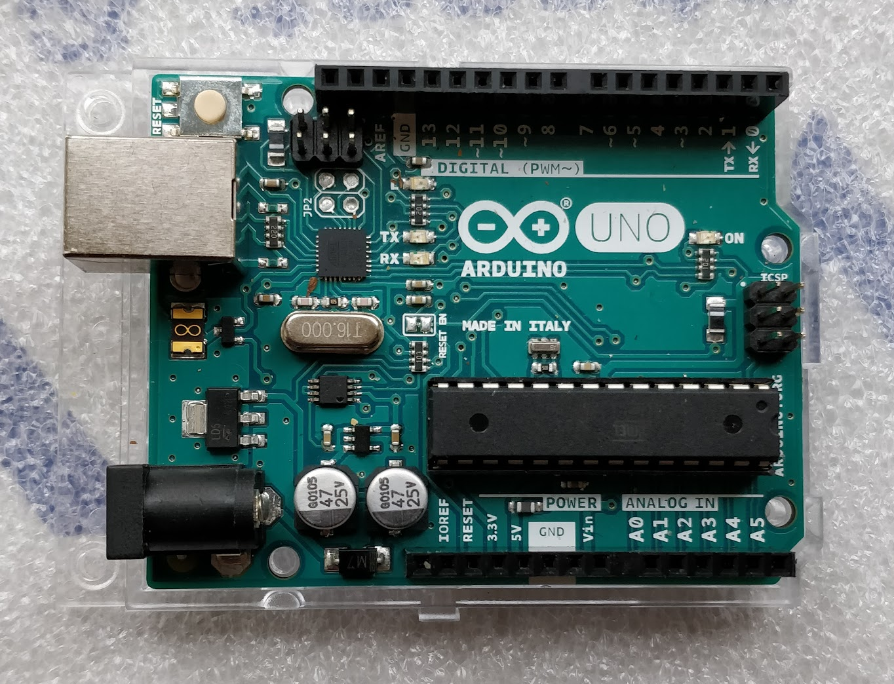
Arduino Uno R3 - (Original Made in Italy)
Atmega328p on board chip
14 Digital I/O pins from which 6 PWM pins and 6 analog pins
SRAM = 2KB
EEPROM = 1KB
Flash memory = 32KB
Clock Speed = 16Mhz
http://www.hobbytronics.co.uk/arduino-uno-r3

Slide 9
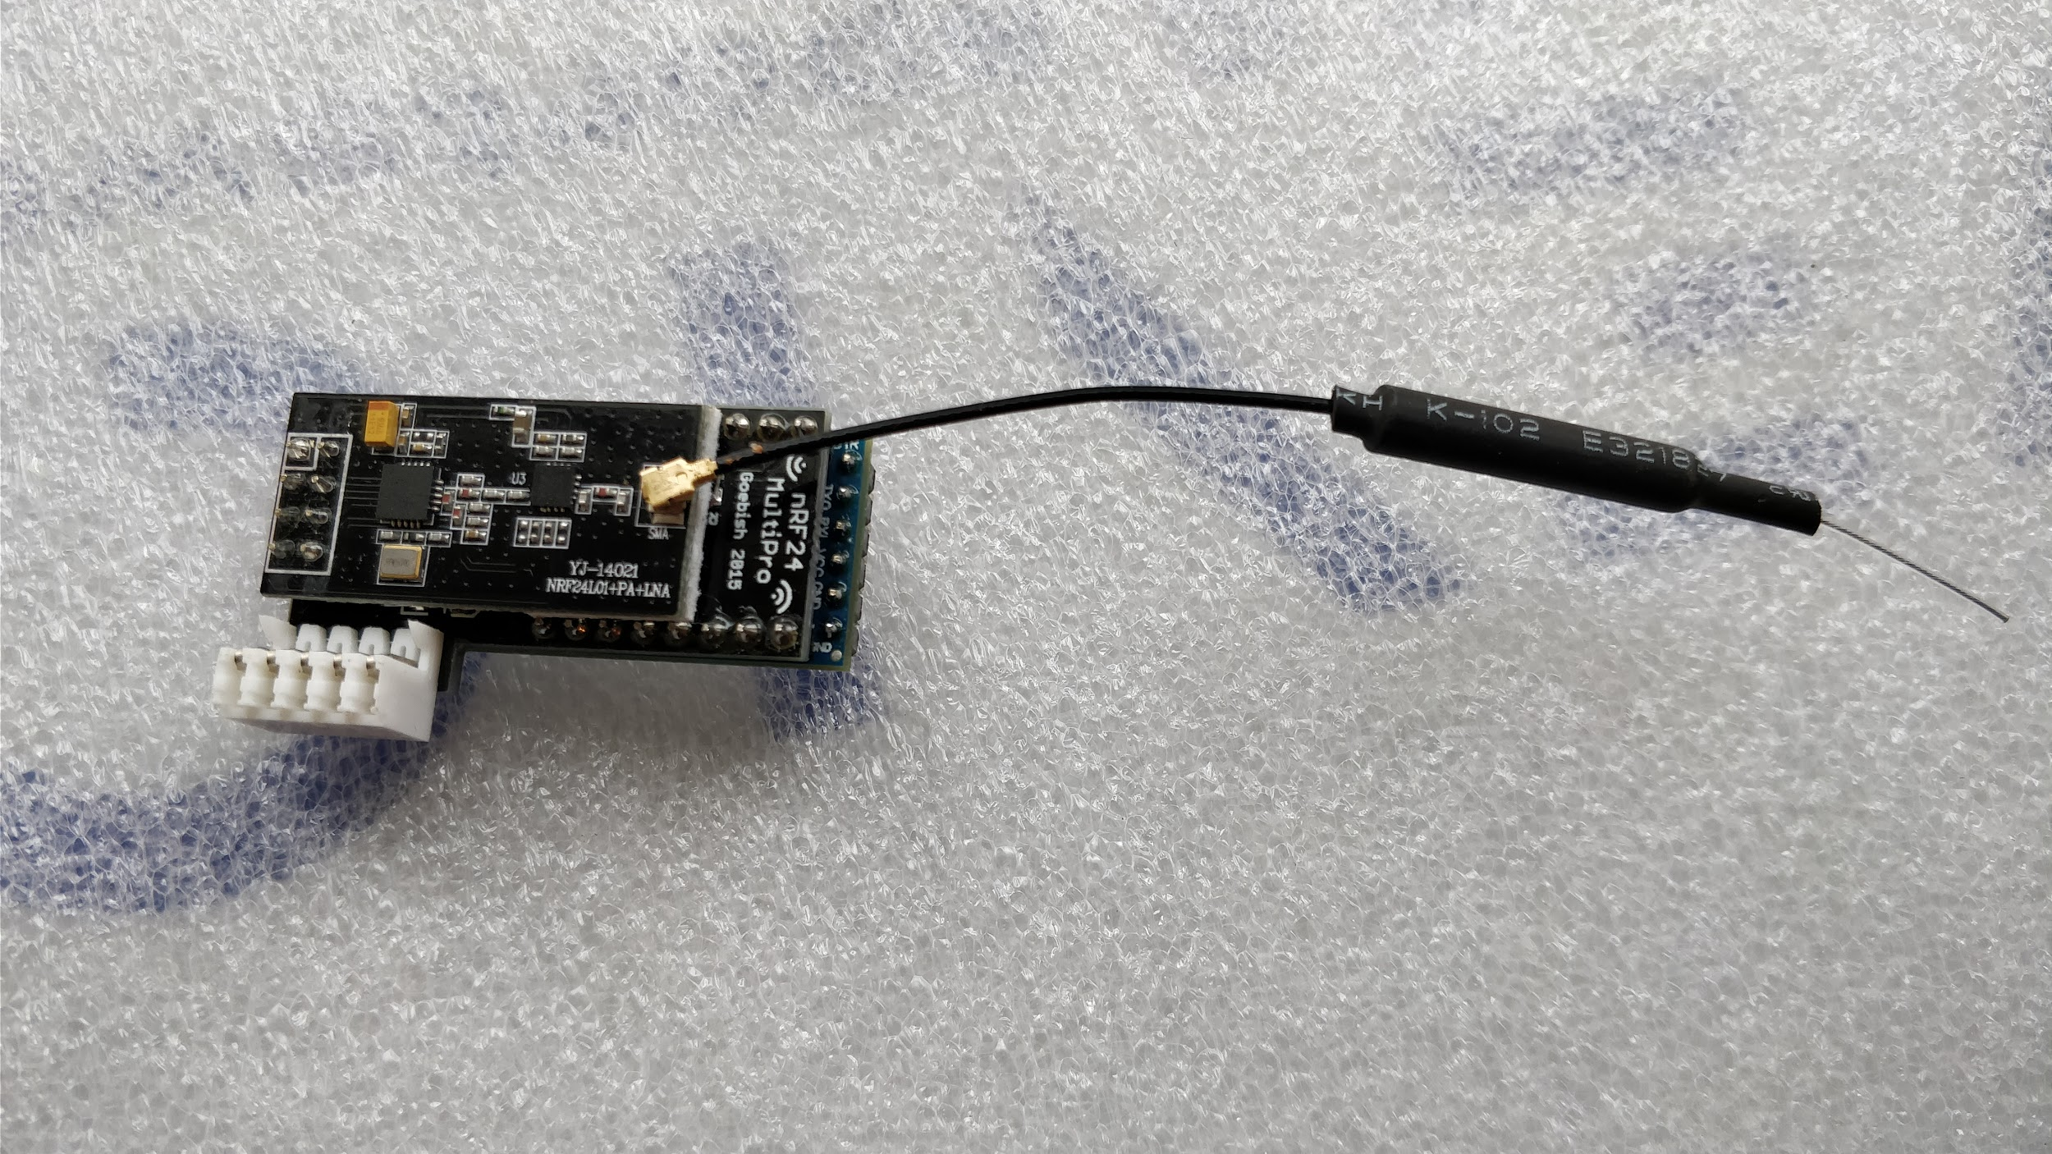
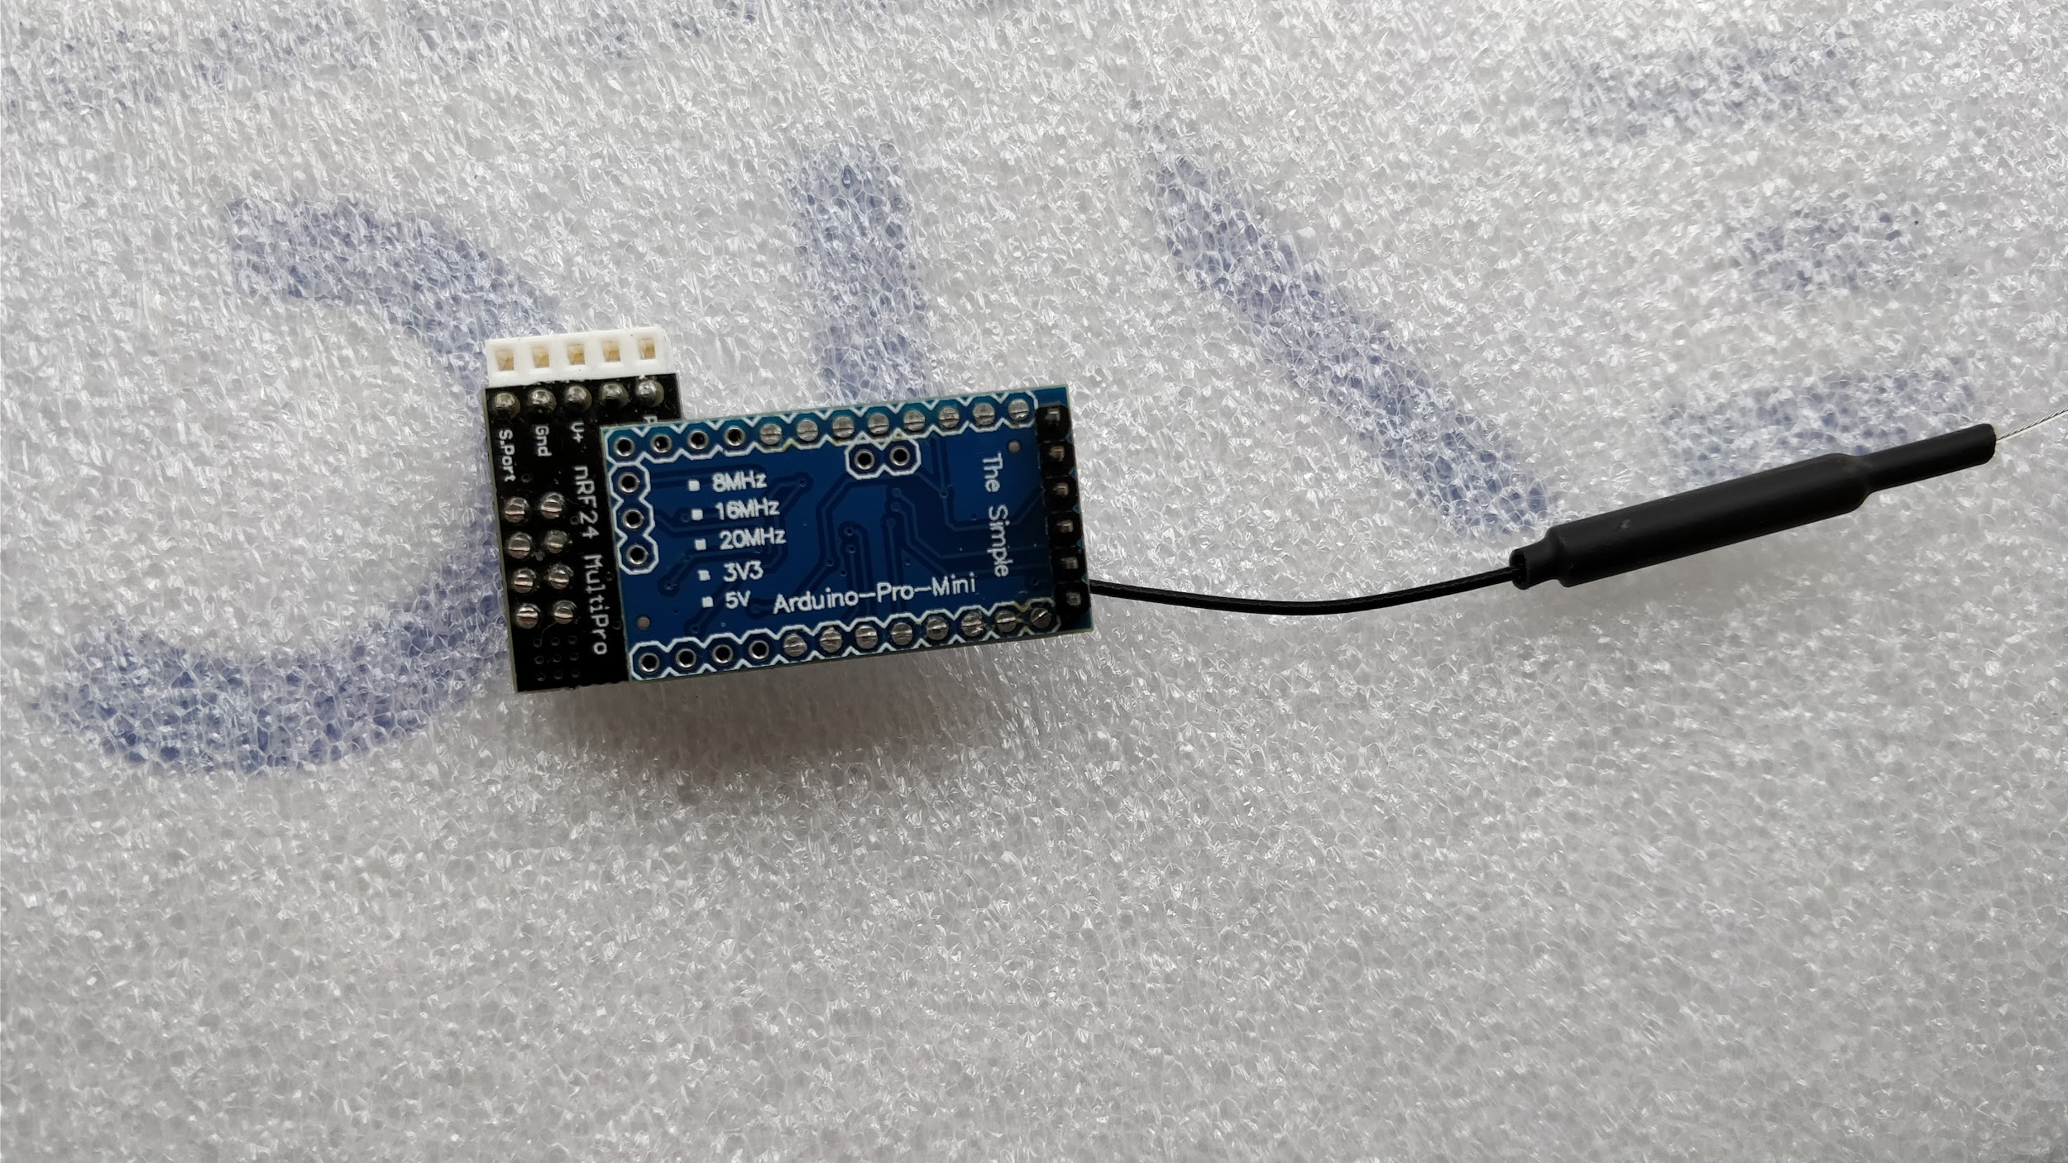
nRF24L01 multiprotocol RC Transceiver
Combination of 3 modules
Arduino Pro mini
nRF24L01 + PA + LNA wireless module
nRF24L01 adapter
~120 foots along with obstacles
Can operate on 3 modes, 2 mbps, 1 mbps and 250 kbps
https://github.com/goebish/nrf24_multipro
https://www.robotshop.com/media/files/pdf/datasheet-wir020.pdf

Slide 10
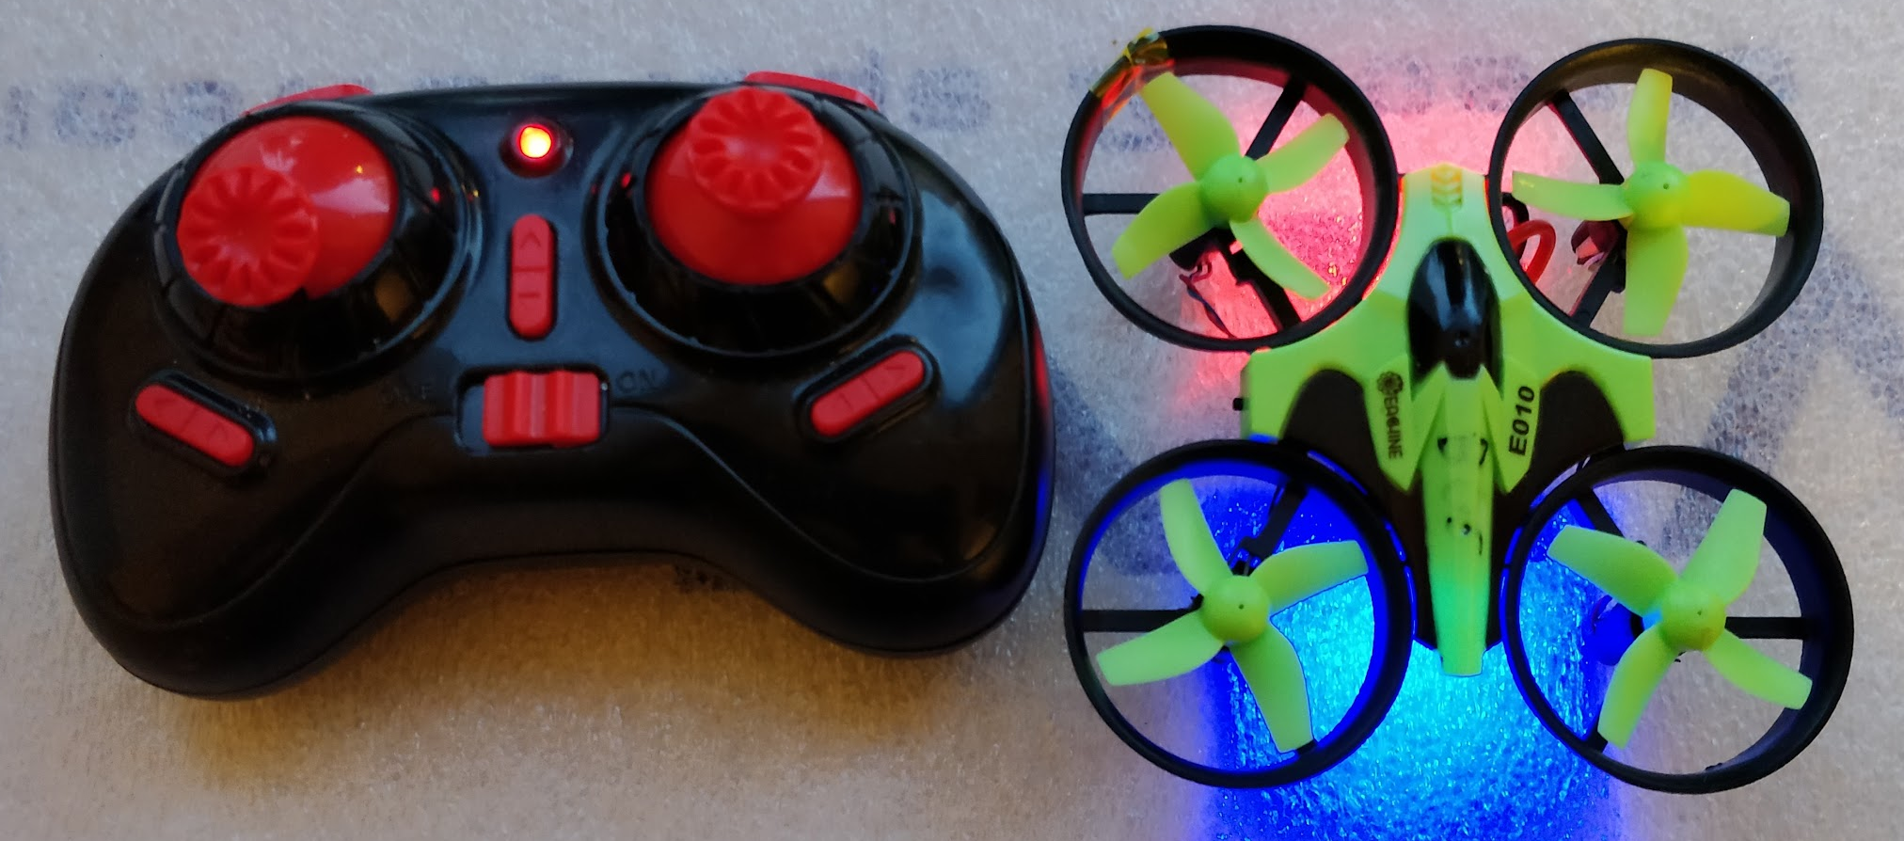
Eachine E010 Drone
2.4 GHZ 6-axis drone
Small and speedy with nice range
5 minutes of Playtime
http://www.firstquadcopter.com/reviews/eachine-e010-mini-quadcopter-review/

Slide 11
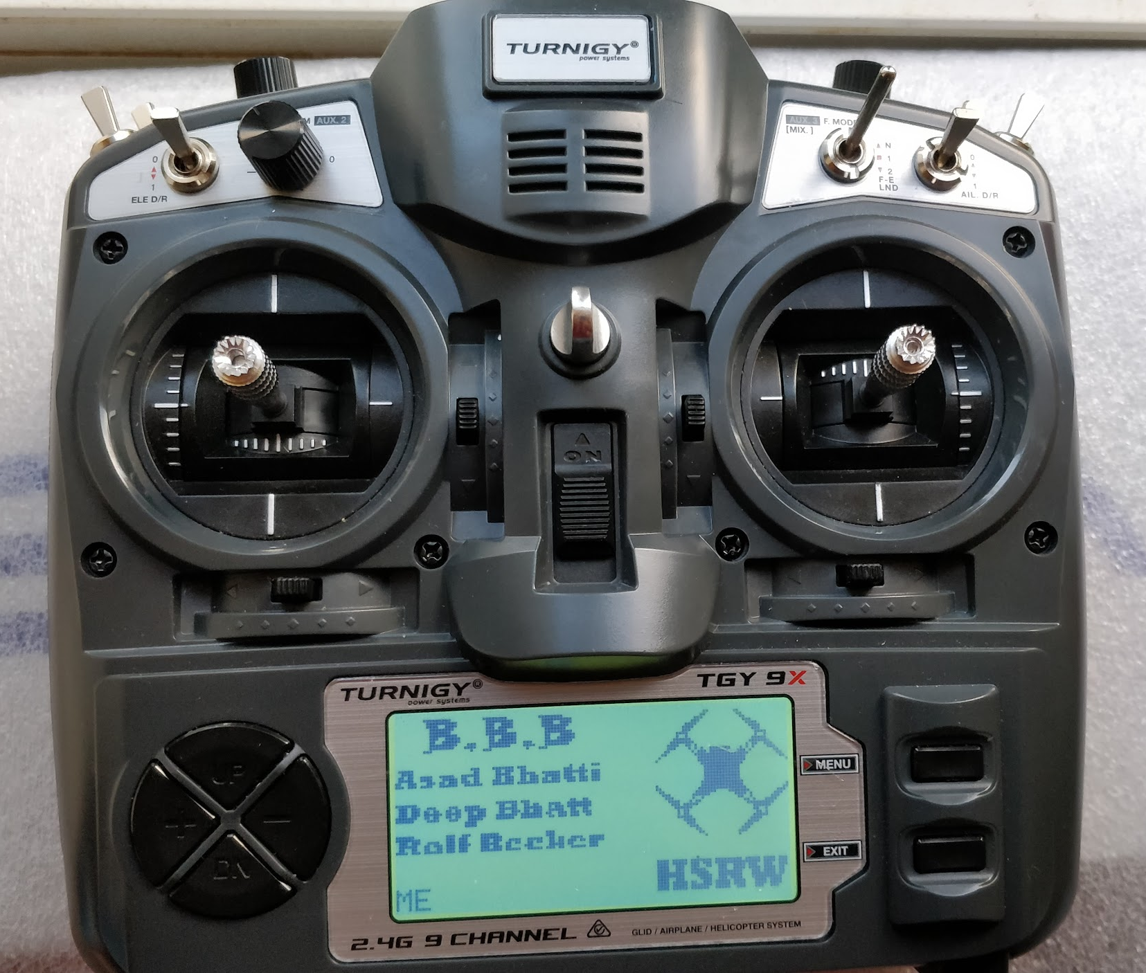
RC Turnigy 9x 9ch transmitter module
2.408-2.475 GHZ range
9 channel module
500 Khz bandwidth
Turnigy reference link

Slide 12
Approach

Slide 13
Approaching steps
Step 1
Step 2
Step 3
Understand and update the reference code Geobish-nRF24L01
Experimented code with Arduino-nRF24L01 module
started experiments with Newly ordered module
Step 4
Step 5
Step 6
Connection test Multipro module - Turnigy9x
Turnigy9x firmware upgrade
Turnigy9x - Multipro module
https://github.com/goebish/nrf24_multipro
Notes:
We started with understanding the reference code.
Next step was to update the code according to requirement.
After ordering nRF24L01 multi-protocol RC transmitter, we started experimenting with that module.
We tried binding the RC transmitter module with Turnigy with the present code and firmware.
Successfully upgraded the firmware for turnigy after making an arduino as ISP programmer.
Successfully connected both the devices after upgradation.

Slide 14
Approaching steps
Step 7
Step 8
Binding between multipro module - Arduino PPM encoder - PC
Driver Ruby script to fly the Drone
Notes:
Successfully bounded arduino with the module after comparing the results of turnigy - RC module
Finally developed a nice command line code to operate drone.

Slide 15
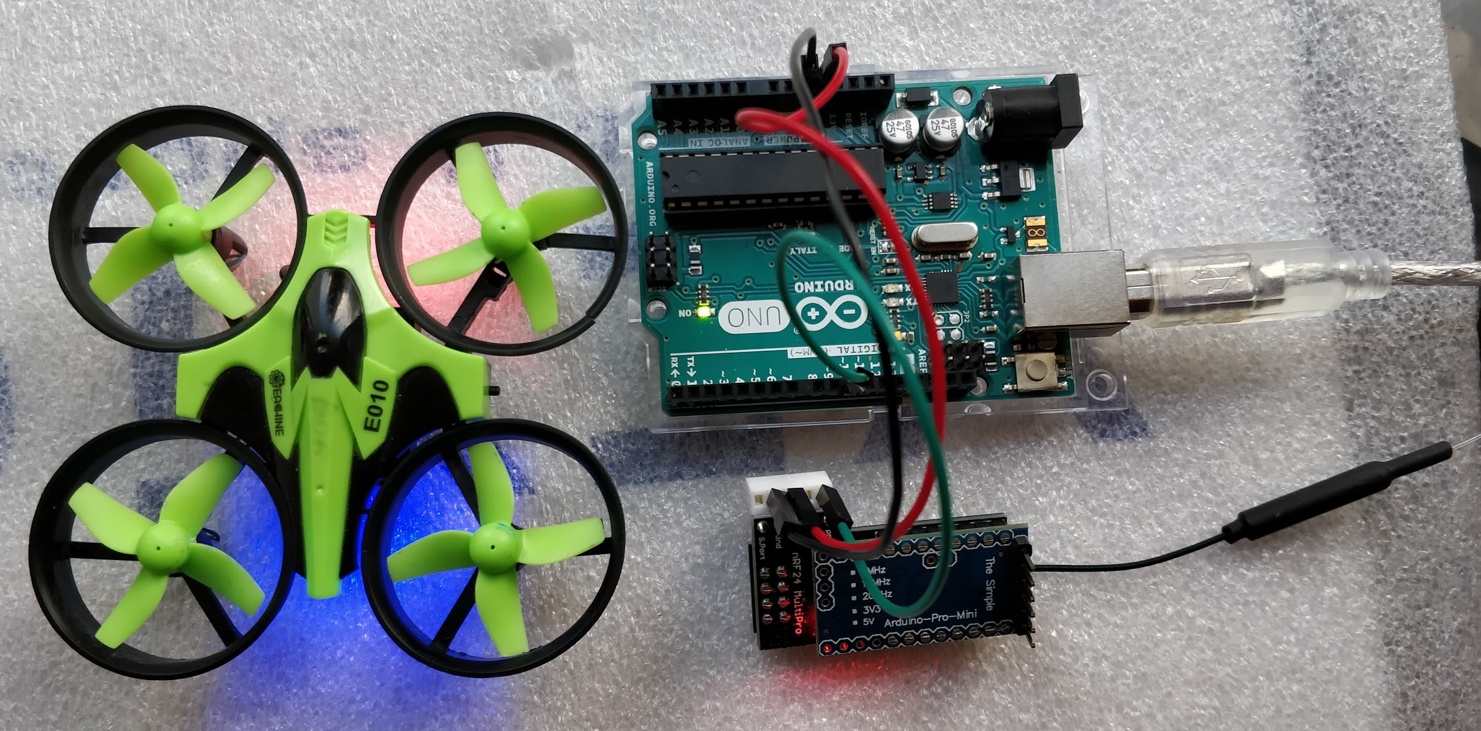
DEMO

Slide 16
Implementation

Slide 17
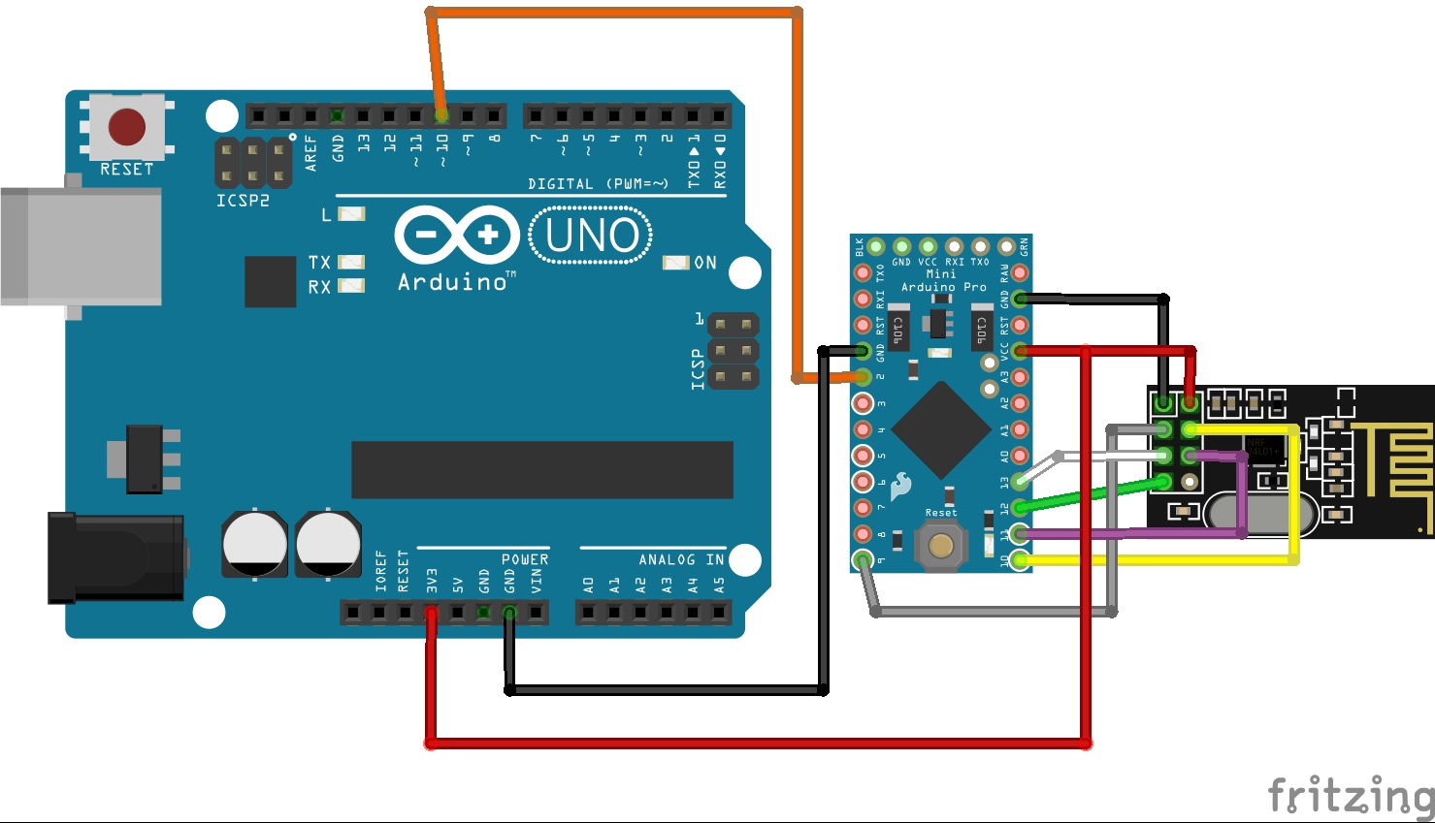

Slide 18
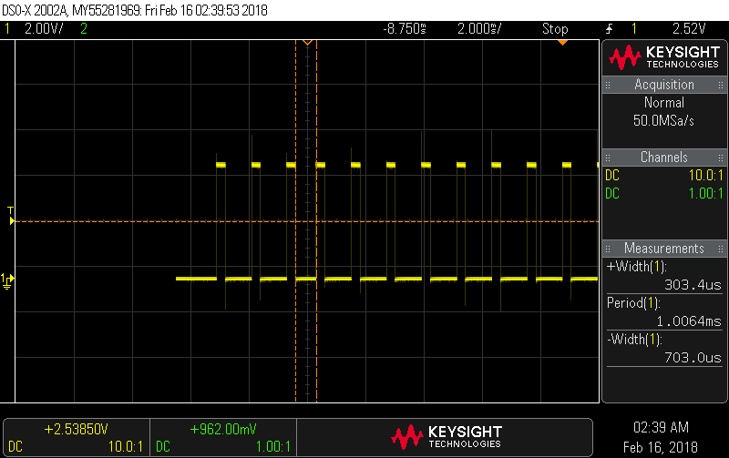
Pulse Position Modulation
Pulse width = 300.4 us
frame length = 22500 us
Each channel represents a period.
https://quadmeup.com/generate-ppm-signal-with-arduino/

Slide 19
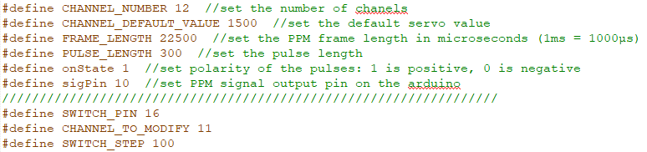
PPM encoder
Defined in code:
A Servo value array
Timer 1 and Timer interrupts
Get commands via serial communication with PC.
Update servo values array
Time interrupts will continuously generate ppm values from the array.

Slide 20
Multiprotocol module
Receive PPM signals from PPM encoder
Selects protocol as per the receiver
Selects frequency for communicating with receiver
Initiate binding sequence.
Start sending commands to drone receiver.

Slide 21
Future Enhancements
Generate PPM signals from the same Arduino Pro Mini board
Include camera on the drone
Design a control loop to fly drone
Minimize the whole system to a USB device

Slide 22
References
https://quadmeup.com/generate-ppm-signal-with-arduino/
https://github.com/goebish/nrf24_multipro
https://www.ebay.de/itm/RC-Turnigy-9X-9Ch-Transmitter-w-Module-iA8-Receiver-Mode-1-AFHDS-2A-system-/222722657743?_trksid=p2385738.m4383.l4275.c10
https://github.com/goebish/nrf24_multipro
http://www.firstquadcopter.com/reviews/eachine-e010-mini-quadcopter-review/
https://www.robotshop.com/media/files/pdf/datasheet-wir020.pdf
http://www.hobbytronics.co.uk/arduino-uno-r3

Slide 23
THANK YOU
DANKESCHÖN

